Slide 1
WHAT WE DO, AND HOW WE DO IT.
www.girikon.com
GirikForm Builder Feature Guide
Headquarters: 15433 North Tatum Boulevard, Suite 105, Phoenix, AZ, 85032, USA | 480-241-8198 / 480-432-1110 | sales@girikon.com
Notes:
MAY I RECORD
For over 6 years now Girikon has offered stellar software development services whilst having some of the most competitive pricing in the industry.
We are HIPAA compliant, Certified ISO9001 and ISO 27001
Your data and information is of our upmost concern

Slide 2
ABOUT GIRIKFORM BUILDER
Data Collection to Salesforce Made Easy
ISO 9001 & 27001 CERTIFIED
ISO 14001 CERTIFIED
SOC2 TYPE 1 & 2 CERTIFIED
HIPAA & GDPR COMPLIANT
GirikForm Builder is a powerful form builder app that helps you create web Forms and Surveys in minutes to capture information to any object, either standard or custom, and easy reporting. No Coding Skills are Needed. 100% built natively on Salesforce!.
Our team of skilled and seasoned technology experts now based in USA, India, Australia and are there to solve your every technology need.
No project is identical, and we work to configure and create custom solutions for each client irrespective of size or complexity.
350+ TEAM MEMBERS
TECHNOLOGY PARTNERS
Salesforce CREST (Gold) Partner,
HubSpot Advance (Diamond) Implementation Partner, Oracle Partner, Talend Partner, Microsoft Silver Partner,
8+ YEARS IN SALESFORCE, DATA MANAGEMENT, HUBSPOT, MOBILE APPS, ATLASSIAN, JAVA, MICROSOFT, CONTENT MANAGEMENT
This Photo by Unknown Author is licensed under CC BY-NC-ND

Slide 3
FEATURE LIST FOR GIRIKFORM BUILDER
Intuitive Drag & Drop Feature
Extensive Theme Options
Customization Options
Advanced Form Elements
Dynamic Form Logics
Build and Deploy Custom Forms, Collect Data on Salesforce wuthin minutes using GirikForm Builder. No CODING Skills Needed!

Slide 4
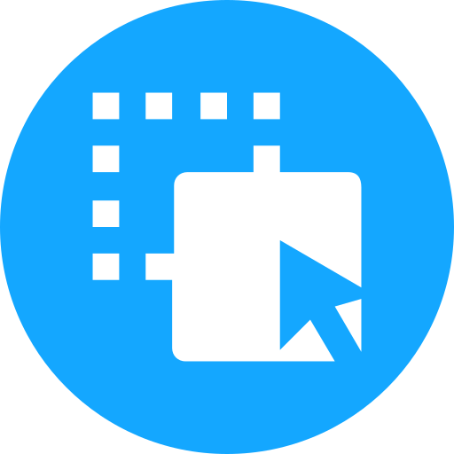
FEATURE LIST FOR GIRIKFORM BUILDER
 | Drag and Drop Functionality | Customization Options |  | Dynamic Form Logics
 | Effortlessly create professional forms using our intuitive drag-and-drop interface. No coding or technical expertise required.​ Simply drag form elements onto the canvas, arrange them as desired, and voila! | Personalize your forms to match your brand's look and feel.​ Customize colors, fonts, and layouts to create a cohesive and branded form experience.​ Tailor form fields to capture the specific information you need from your respondents. |  | Make your forms smart and adaptive with dynamic form logic.​ Show or hide form fields based on user responses, ensuring a personalized and relevant form experience.​ Create a seamless flow through conditional branching, guiding respondents through the form based on their input.

Slide 5
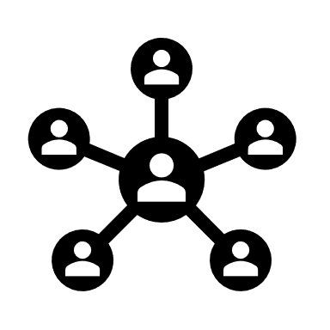
Advanced Form Elements
Validation & Error Handling
Multi-Page Forms
Collaboration & Workflow Optimization
Integration with Salesforce
Data Security & Privacy
Data Collection & Organisation
Insightful Reporting
Export & Import Data

Slide 6
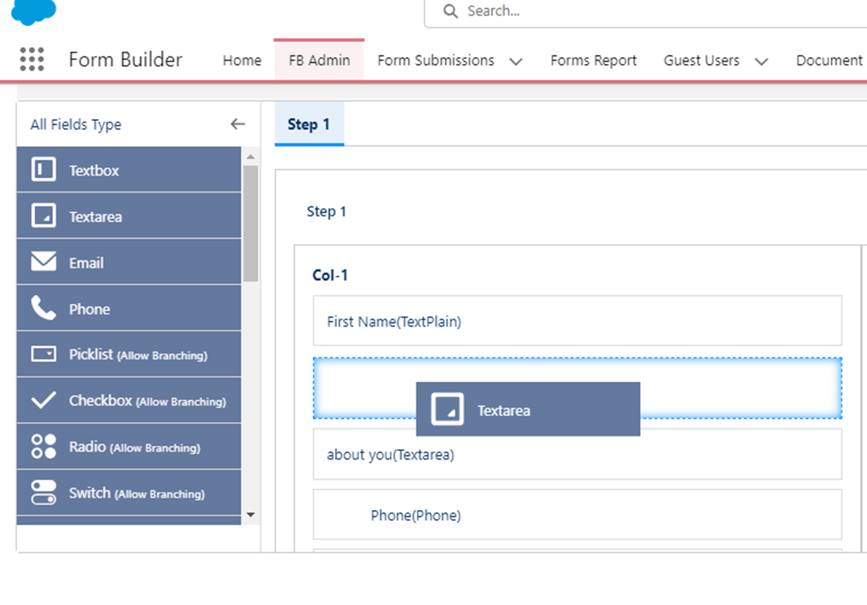
Drag & Drop Functionality
With our intuitive drag and drop feature, you can effortlessly design and customize your forms to fit your exact needs
Drag and Drop Functionality
100% Natively Built on Salesforce
Create Unlimited Forms as and when you want

Slide 7
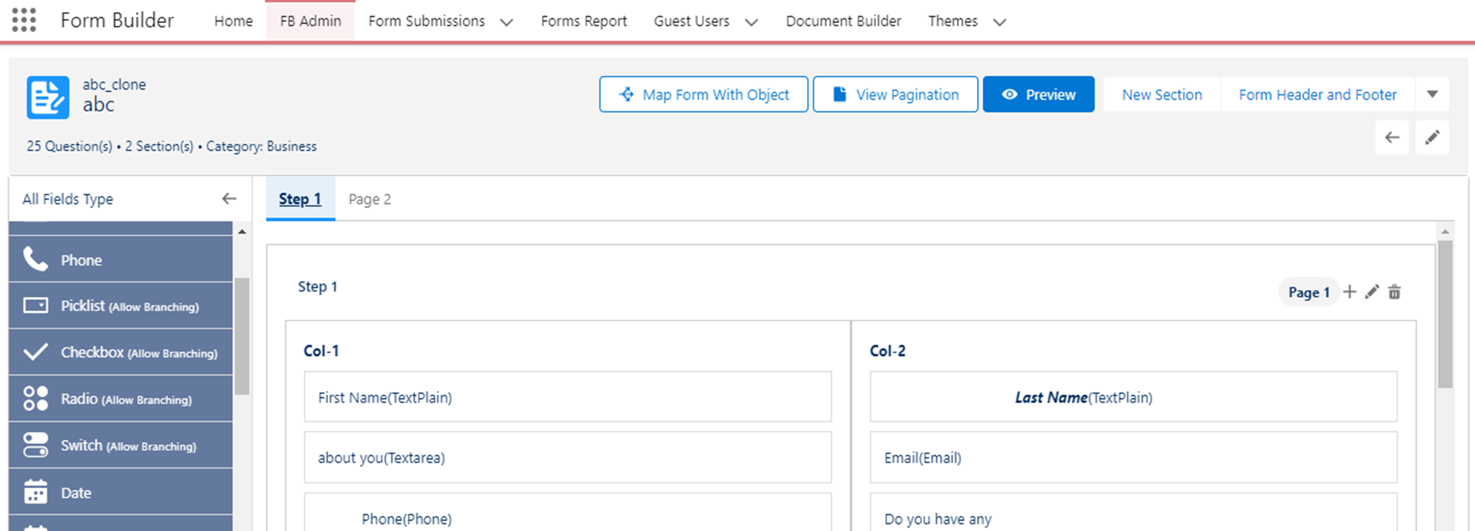
Multiple-Page Forms
Create forms of multiple pages to record as much data as you want!
Multi-page Forms
100% Natively built on Salesforce
Create Unlimited Forms as and when you want

Slide 8
Customization Options
Streamline your workflow by automatically syncing form submissions with Salesforce.
Customization Options
100% Natively built on Salesforce
Create Unlimited Forms as and when you want

Slide 9
Third-Party Integration
Streamline your workflow by automatically syncing form submissions with Salesforce.
DATA COLLECTION & ORGANISATION
INSIGHTFUL REPORTING
EXPORT & IMPORT DATA
Effortlessly export form submissions to popular file formats such as Excel or CSV.​
Share data with stakeholders or import it into other systems for further analysis or processing.​
Seamlessly integrate form data into your existing data ecosystem.​
GirikForm Builder provides robust reporting capabilities to derive actionable insights.​
Generate comprehensive reports and visualize data trends
Analyze form submission metrics, respondent demographics, and patterns to drive data-informed decision-making.
GirikForm Builder simplifies the collection and organization of form submissions.​
Capture data seamlessly through your forms and store it securely in a centralized location.​
Organize form submissions based on form types, dates, or other criteria for easy retrieval and analysis.​

Slide 10
FEATURES FOR COLLABORATION & WORKFLOW OPTIMIZATION
Stay Informed about form submissions with GirikFormBuilder's tracking capabilities.​
Track and manage form submissions with timestamps, user details, and submission status.
Receive real-time notifications when a form is submitted, keeping you updated on new responses.​​
GirikFormBuilder enables seamless collaboration among team members involved in form creation and management
Assign roles and permissions to team members, ensuring appropriate access levels and responsibilities.​
Collaborate in real-time, track changes, and communicate effectively within the platform.
Automate approval notifications and easily track the status of form approvals.
Streamline your form creation workflow with GirikFormBuilder's approval processes.
Define approval stages and designate approvers to ensure quality control and compliance.​​
GirikFormBuilder helps you maintain version control of your forms.​
Keep track of form revisions and changes, ensuring accuracy and consistency.
​ Easily revert to previous versions if needed, reducing the risk of errors and confusion.

Slide 11
FEATURES FOR SEAMLESS FORM DEPLOYMENT
Embed Forms Anywhere​
GirikForm Builder offers flexible options to deploy your forms seamlessly.​
Easily embed forms on your website, blog, or landing pages for a seamless user experience.​
Share form links via email, social media, or messaging platforms to reach a wider audience.
Mobile Friendly Forms​
Ensure a smooth and user-friendly experience for respondents on any device.​
GirikFormBuilder automatically optimizes forms for mobile responsiveness.​
Capture data from users on smartphones and tablets, expanding your reach and accessibility.

Slide 12
FEATURES FOR ENHANCED USER EXPERIENCE
Responsive & Engaging Forms​
GirikForm Builder focuses on delivering a user-centric form filling experience.​
Create visually appealing forms that captivate respondents and encourage completion.​
Responsive design ensures optimal form display and functionality across different devices.
Auto-Fill and Pre-Filled Options​
Simplify the form-filling process for users with auto-fill and pre-filled options.​
Leverage browser capabilities to automatically populate form fields with known user information.​
Enable pre-filled options based on previous form interactions, saving time and enhancing convenience.
Conditional Form Logics​
Create dynamic and personalized form experiences using conditional form logic.​
Show or hide form sections or fields based on user responses, keeping forms concise and relevant.​
Improve usability and user satisfaction by tailoring the form to individual needs and preferences.
Error Handling & Validation​
Guide users through the form completion process with clear error handling and validation.​
Highlight any errors or missing information in real-time, allowing users to correct mistakes promptly.​
Improve user experience by providing helpful error messages and instructions for seamless form submission.
​

Slide 13
Thank You!
Headquarters: 15433 North Tatum Boulevard, Suite 105, Phoenix, AZ, 85032, USA www.girikon.com | sales@girikon.com
USA Development Centers:
Phoenix Center - 15433 N Tatum Blvd, Suite 102/105, Phoenix, AZ, 85032
Dallas Center - 3010 W Lyndon B Johnson Freeway, Suite 1200, Dallas, TX 75234
India Development Centers:
Noida Center – B24,Sec 65, Noida, 201301
Bengaluru Center - 206, 2nd Floor, Brigade IRV, Whitefield, Bengaluru, 560066
Australia Development Center:
Level 1 & 2 – 161 Collins Street, Melbourne 3000
DISCLAIMER Any/all trademarks used throughout the publication belong to the irrespective owners. Contact Girikon at +1-480-241-8198 or sales@girikon.com. Girikon is a Registered Trademark of Girikon Inc, based out of Phoenix, USA. This publication and features described here in are subject to change without notice. Girikon assumes no responsibility for errors or omissions. All offers are subject to final approval by Girikon.
DISCLAIMER OF WARRANTY
Information contained in this publication is provided "as is," without warranty of any kind. In particular, Girikon, its employees, officers, and members make no warranties or representations, expressed or implied, as to the fitness for a particular purpose or merchantability of any product, apparatus, downloaded computer software product, service, or the usefulness, completeness, or accuracy of any processes, methods, downloaded computer software product, or other information contained, described, disclosed, or referred to herein. Girikon, its employees, officers and members – make no representation that the use of any product, apparatus, process, method, downloaded computer software product, or other information will not infringe privately owned rights.
DISCLAIMER OF LIABILITY
In no event shall Girikon, its employees, officers or members be liable for any direct, indirect, punitive, incidental, special, or consequential damages or any damages whatsoever including ,without limitation, damages for loss of use, data, or profits, arising out of or in anyway connected with the use of this publication the provision of or failure to provide services, or for any information, software, products, services, or graphics obtained through this publication, or otherwise, whether based on contract, tort, strict liability, or otherwise, even if Girikon, its employees, officers and members have been advised of the possibility of damages.
DISCLAIMER OF ENDORSEMENT
Reference to any specific product, service, process, or method by trade name, trademark, service mark, manufacturer or otherwise on this website does not constitute an implied or expressed recommendation or endorsement, or favouring by Girikon, its employees, officers or members, and shall not be used for advertising or product endorsement purposes.

